Slide 1
Electric Schematic to simulinK
Computer Vision (001) by Kim Gunhee – Spring 2018 SNU
Cem Gülsan – Hamburg University of Technology
Thomas Frei – University of Applied Sciences Northwestern Switzerland
Christian Vecsei – RWTH Aachen
Andreas Boltres – Karlsruhe Institute of technology

Slide 2
Idea
Complicated electric circuits confuse unexperienced engineers
Circuit behavior unpredictable
SIMULINK allows to simulate this behavior
This is where Computer Vision comes in:
Analyze the schematic
Find objects and connections
Generate a SIMSCAPE model

Slide 3
Steps
Image Preprocessing
Image Analysis
Output Generation

Slide 4
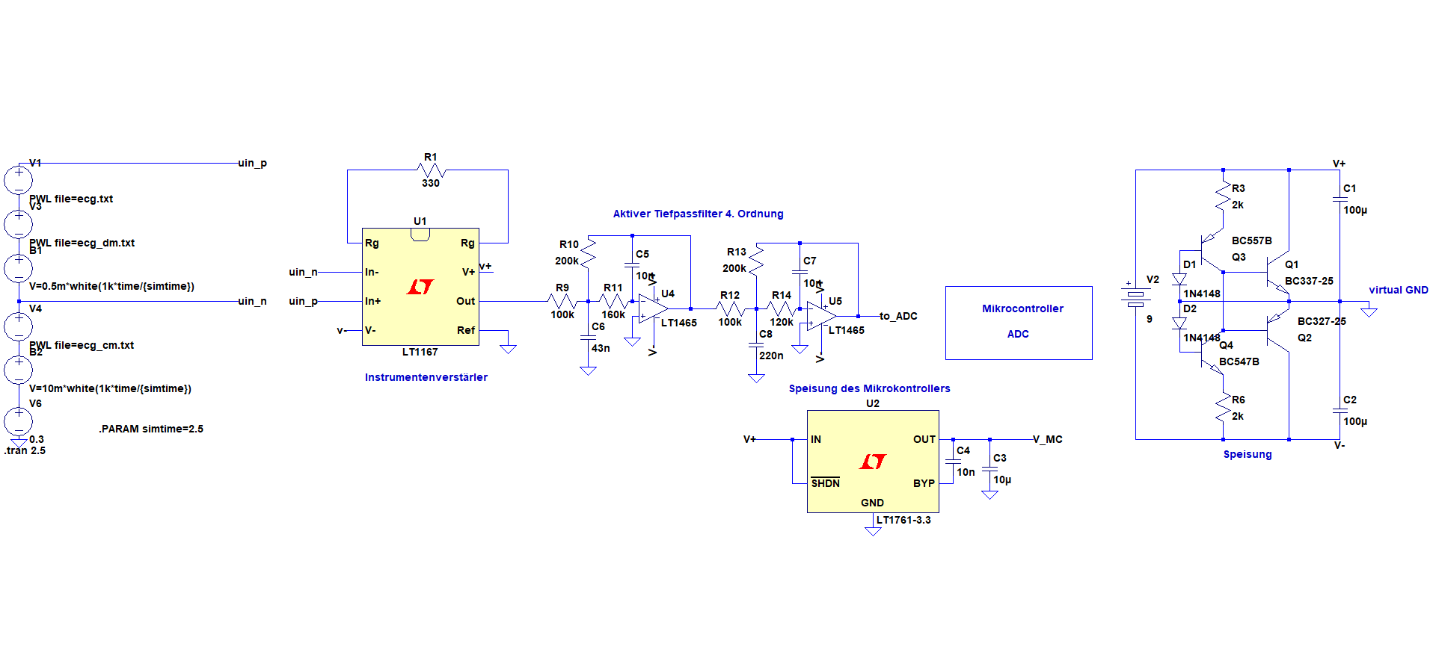
LTSpice Schematics

Slide 5
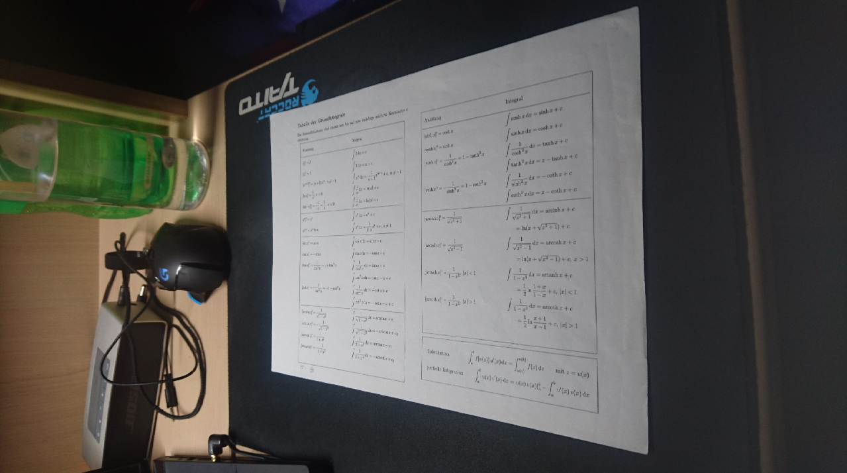
Paper recitfication
Selectable option between screenshot and photo
Detecting corners of image and warp image

Slide 6

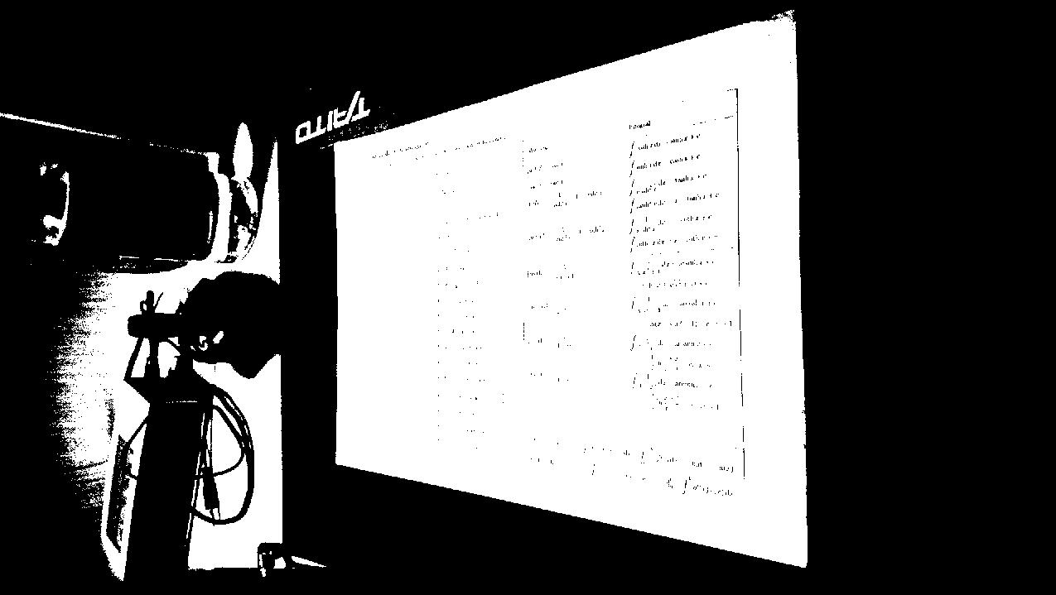
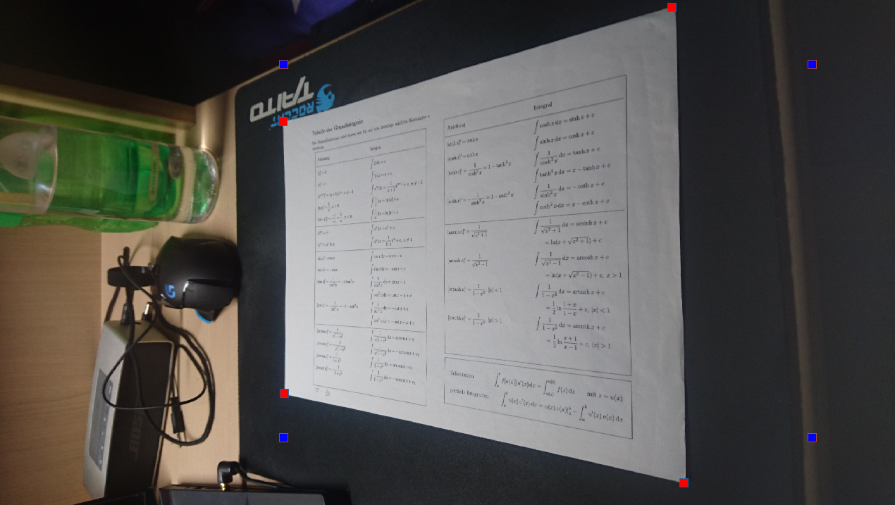
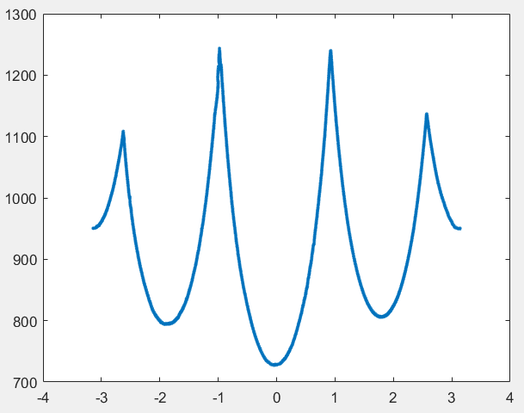

Slide 7
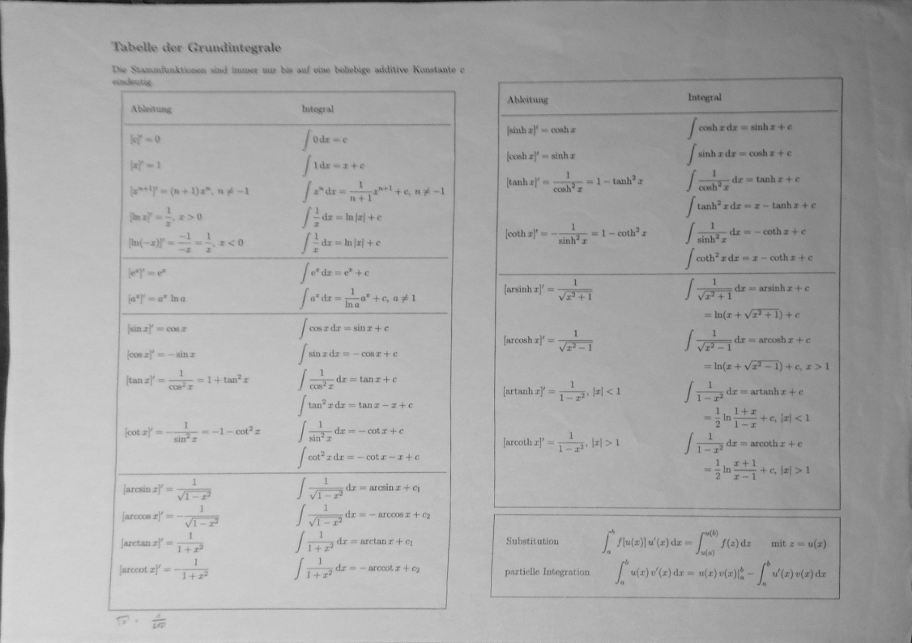

Slide 8
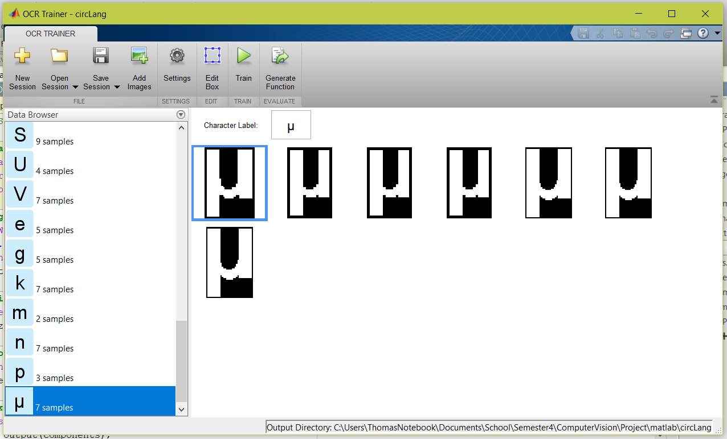
Optical character detection (OCR)
Detect letters of trained language on whole image
Remove found characters
Allow selecting of additional regions

Slide 9
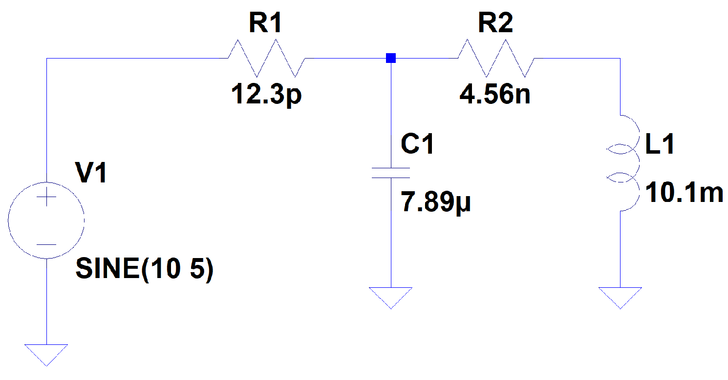

Slide 10
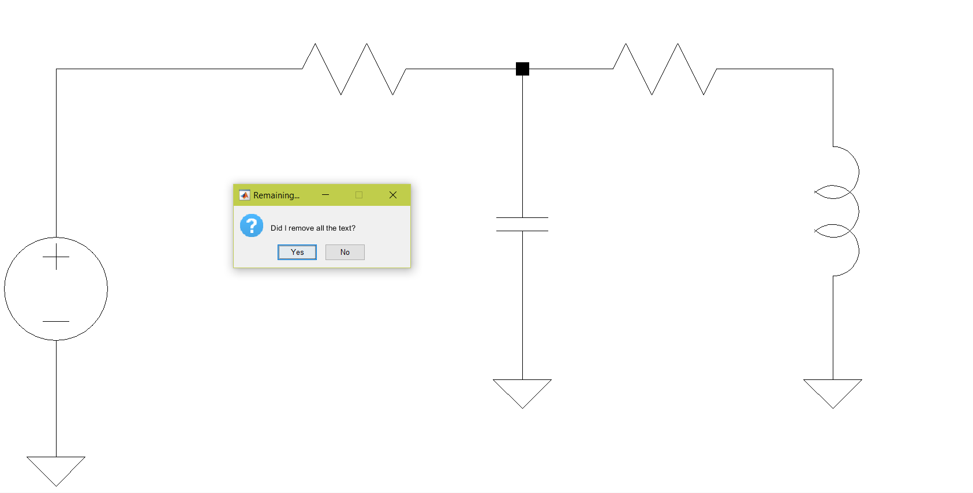

Slide 11
Image Analysis Algorithm
Optical character recognition (OCR)
Find and remove Text
Hough transform
Find scale
Object detection
Find, classify and remove electrical elements
Wire detection

Slide 12
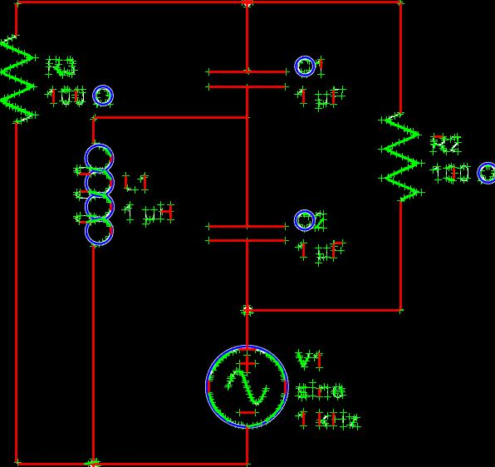
Geom. Primitives
Lines
Circles
Corners

Slide 13
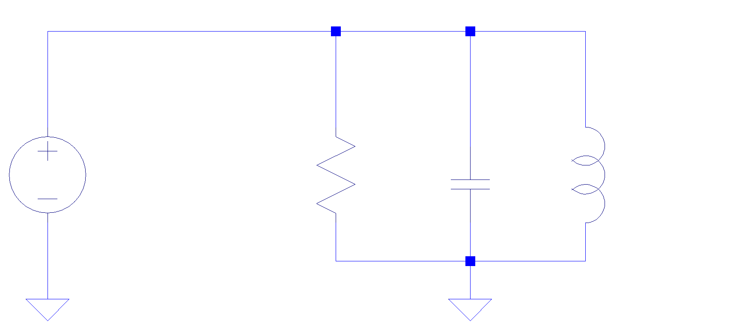
Object detection

Slide 14
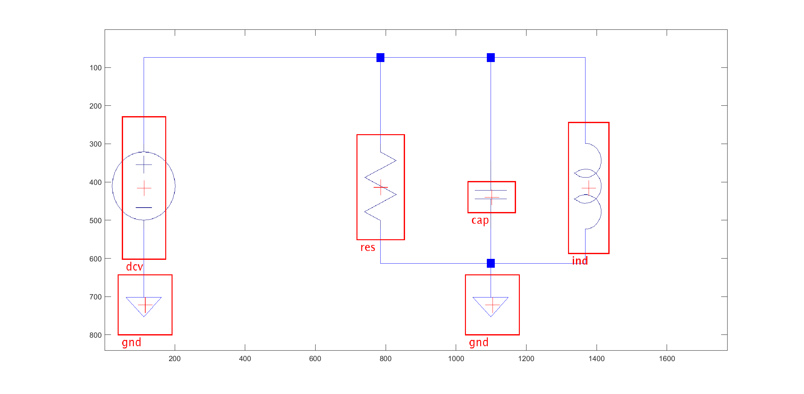
Object detection
Basic Approach: Sliding window

Slide 15
Object detection
Problems
Scale
Rotation
Perspective
Uncertainty
Confusion
Solutions
Scale info from Hough
Only 90° rotation
Rectify by preprocessing
Tolerant algorithm
Scoring

Slide 16
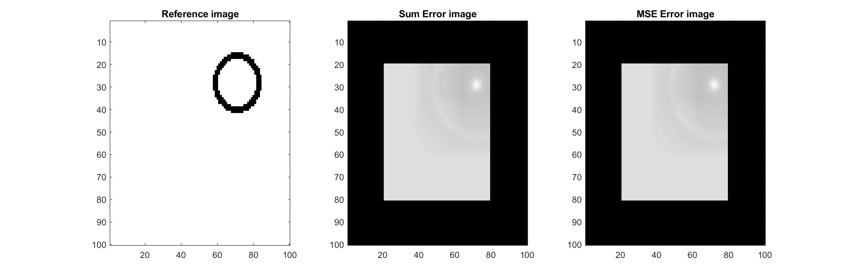
Object detection – Error metric

Slide 17
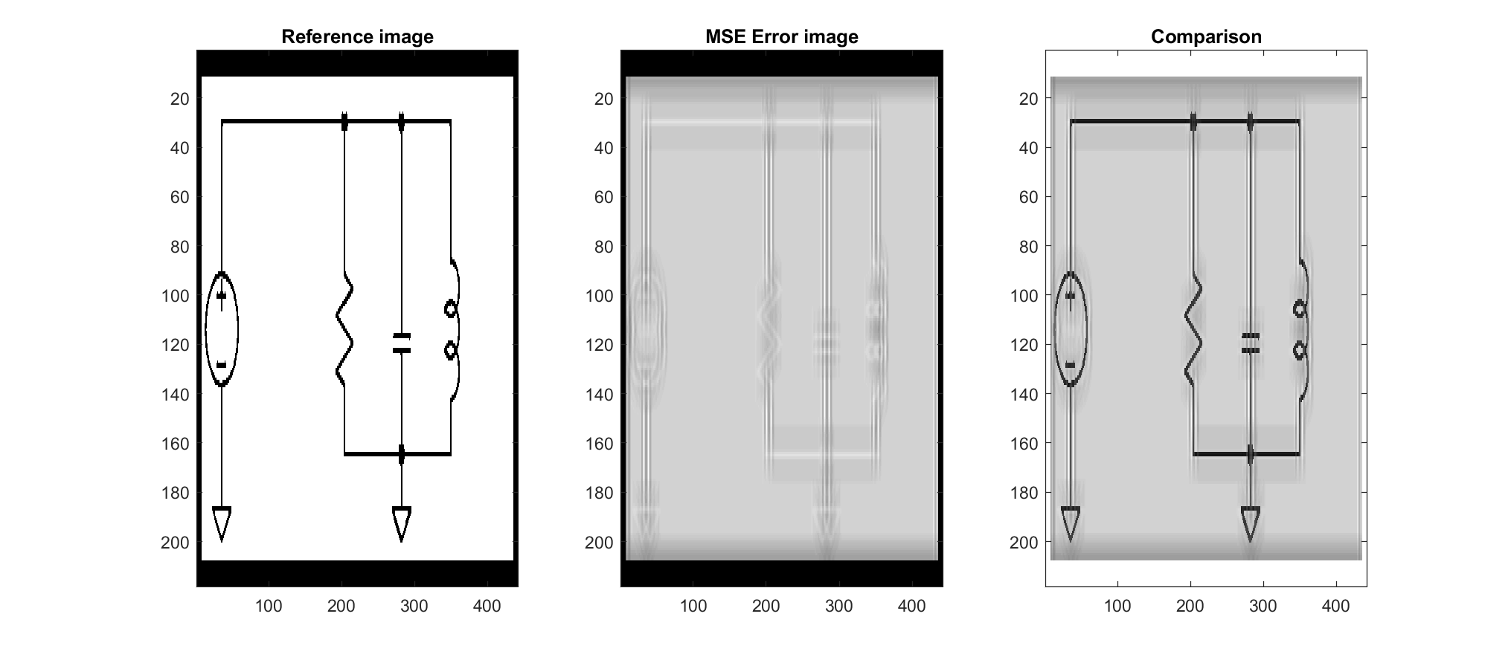
Object detection – Error Image

Slide 18
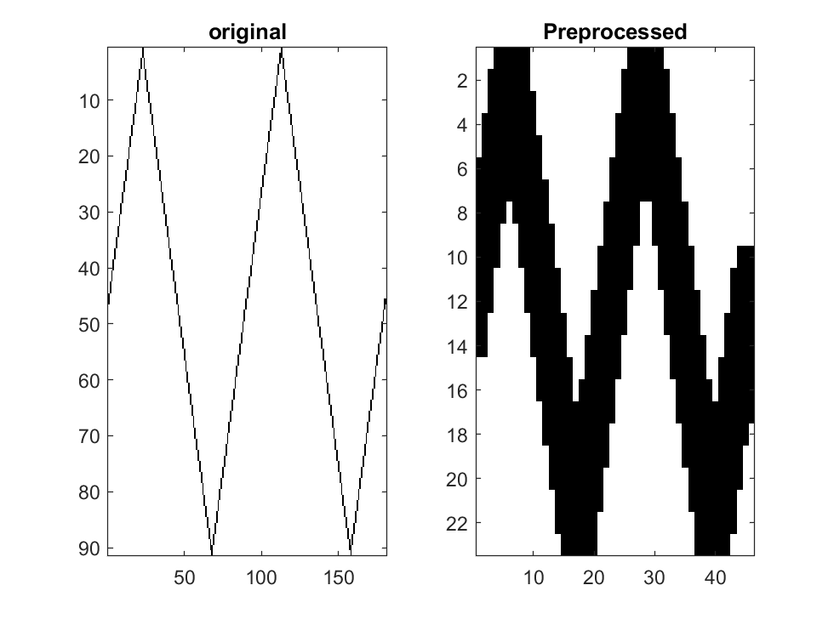
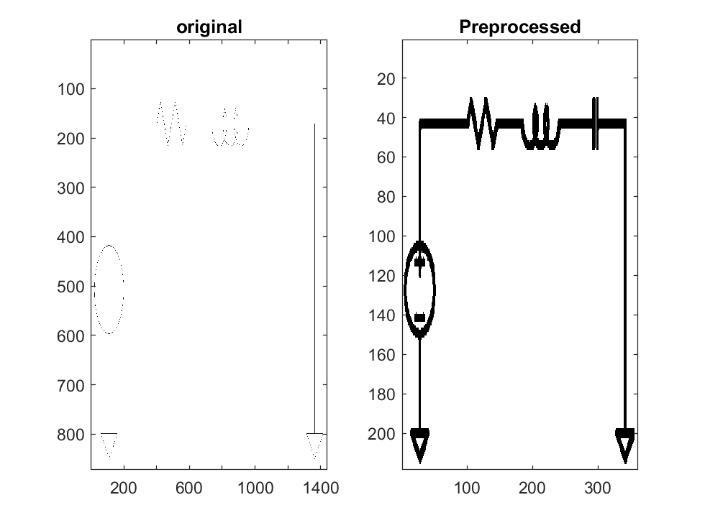
Object detection – Thickening

Slide 19
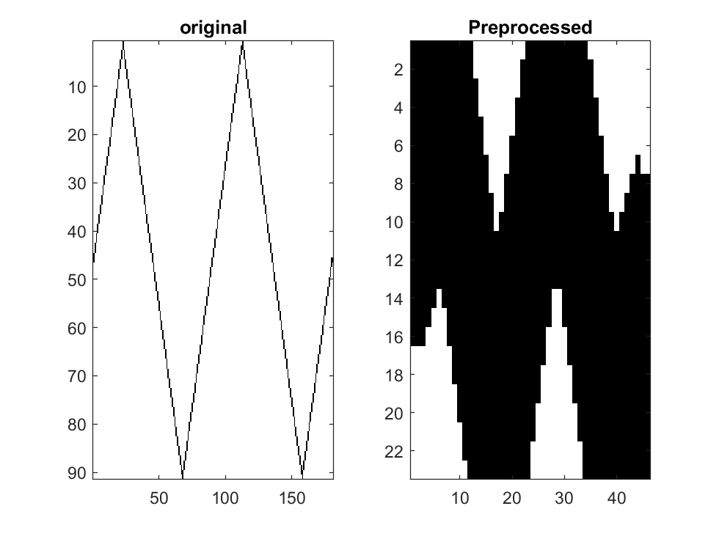
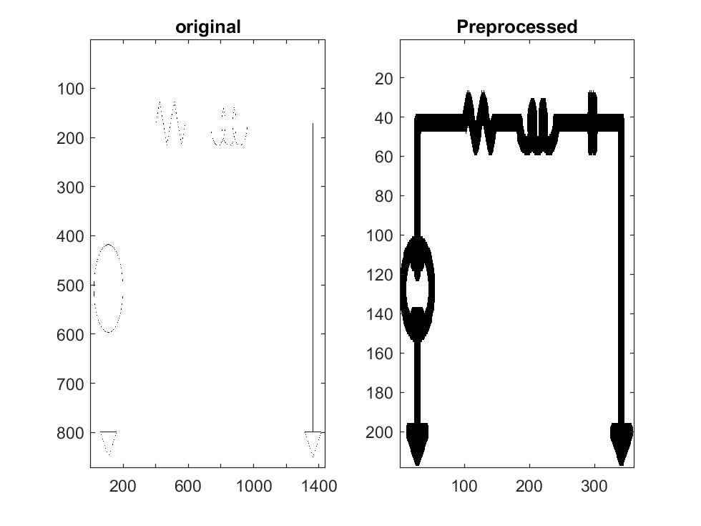
Object detection – Thickening

Slide 20
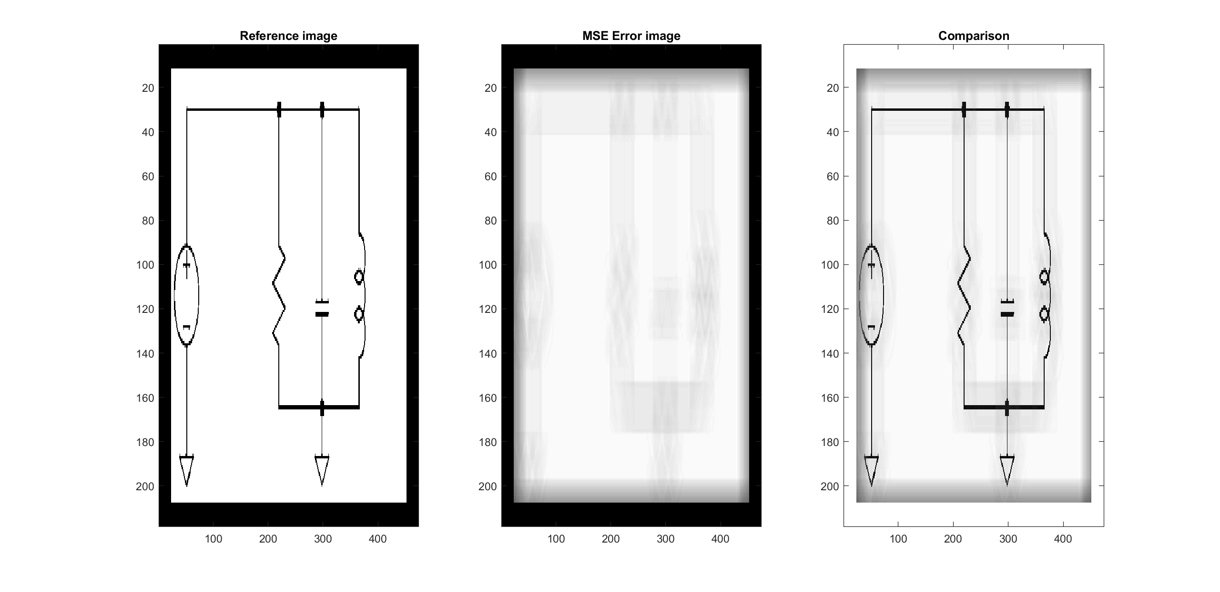
Object detection – Errorimage, T = 1

Slide 21
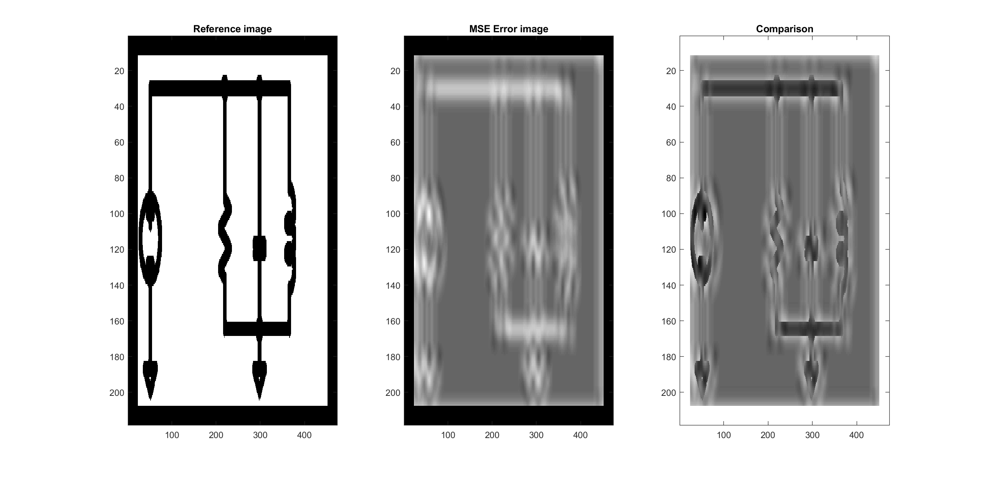

Object detection – Errorimage, T = 19

Slide 22
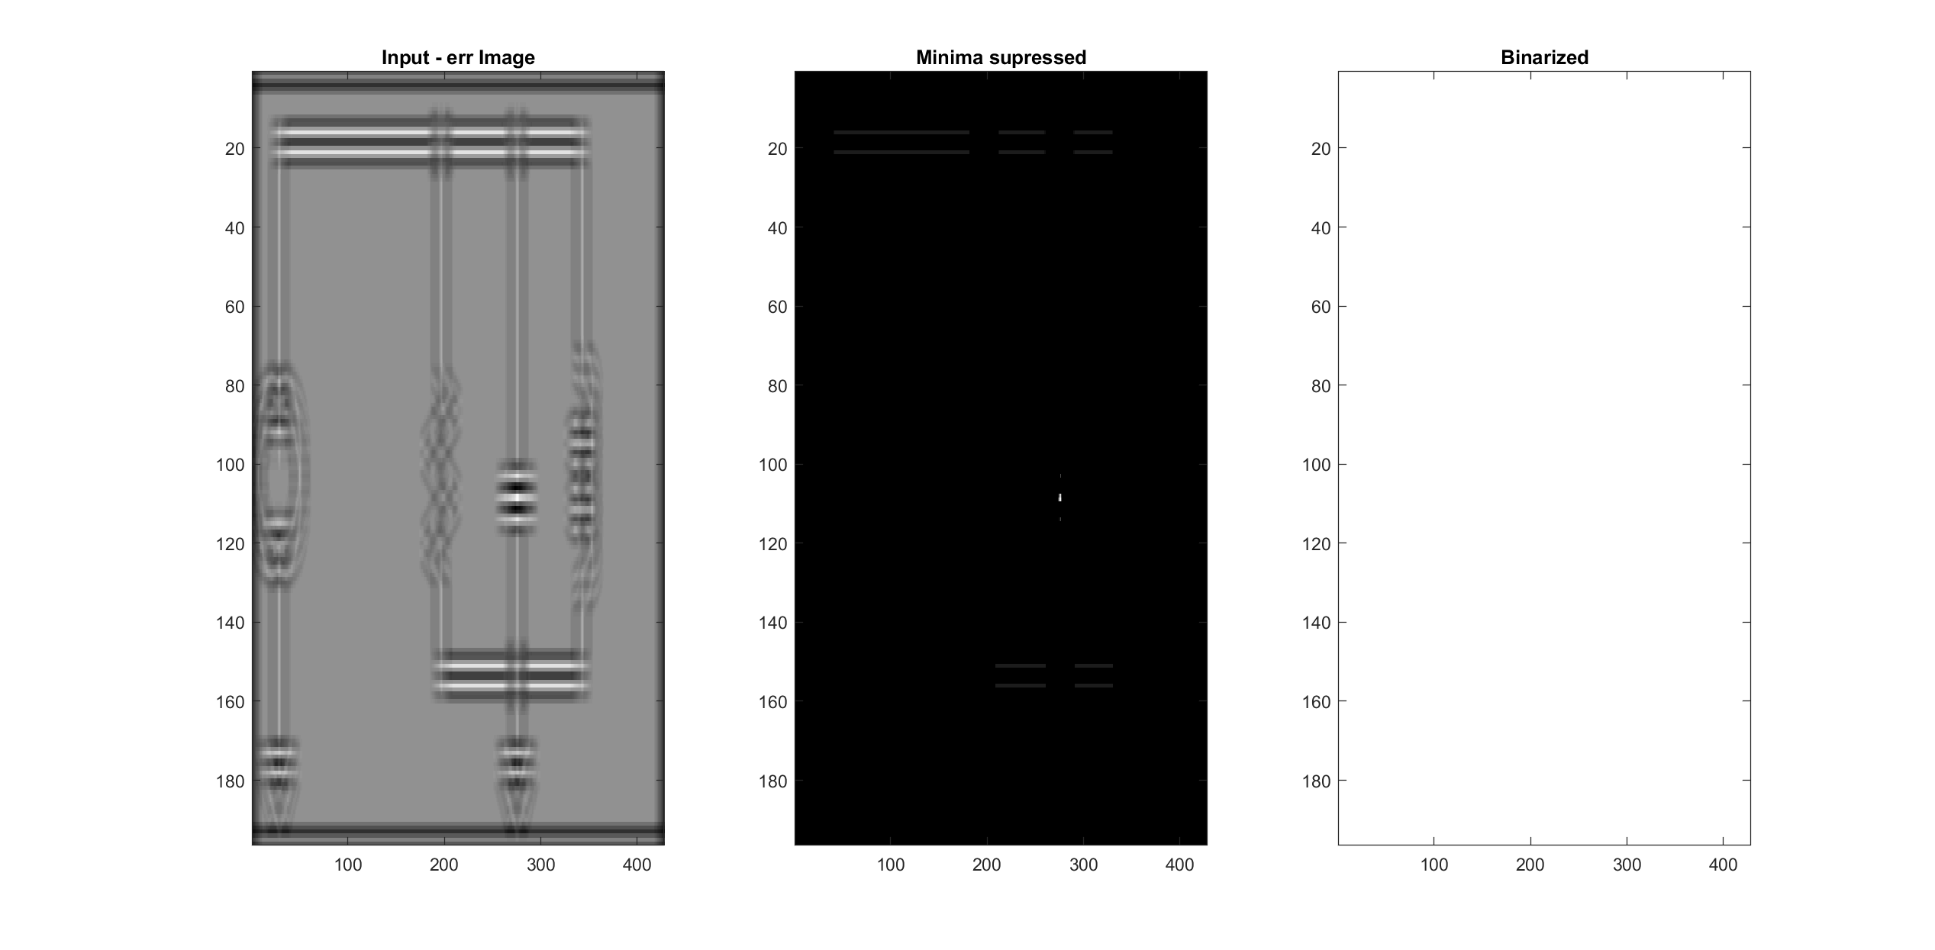
Object detection – Binarize Fail Type 1

Slide 23
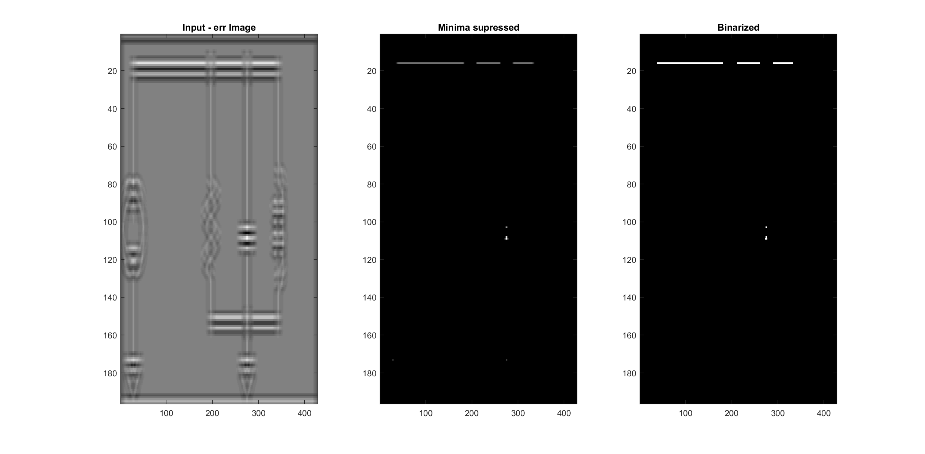
Object detection – Binarize Fail Type 2

Slide 24
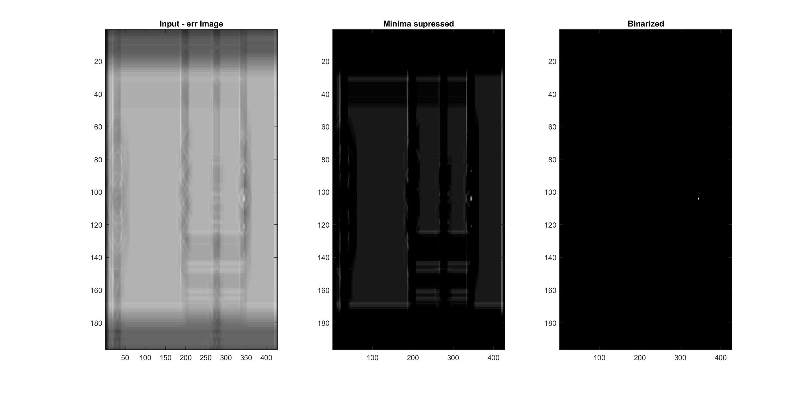
Object detection – Binarize Success

Slide 25
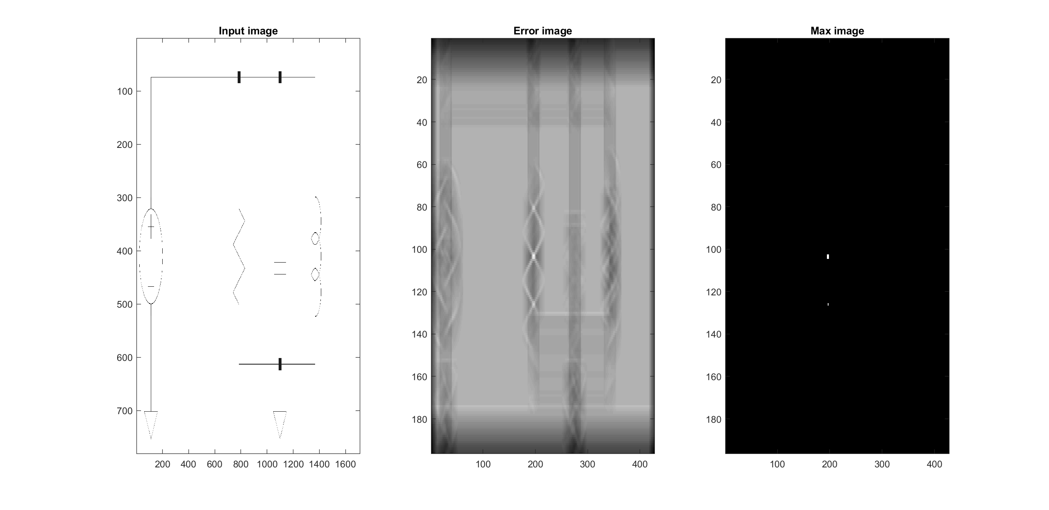
Object detection – Find Objects

Slide 26
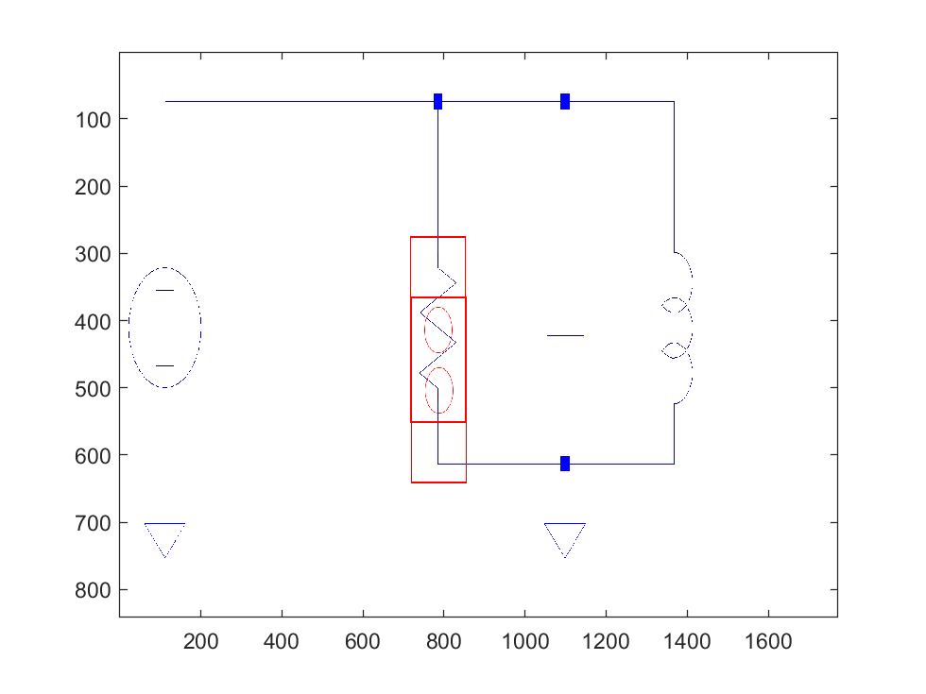
Object detection – Find Objects

Slide 27
Object detection – Candidate selection
(See output files)

Slide 28
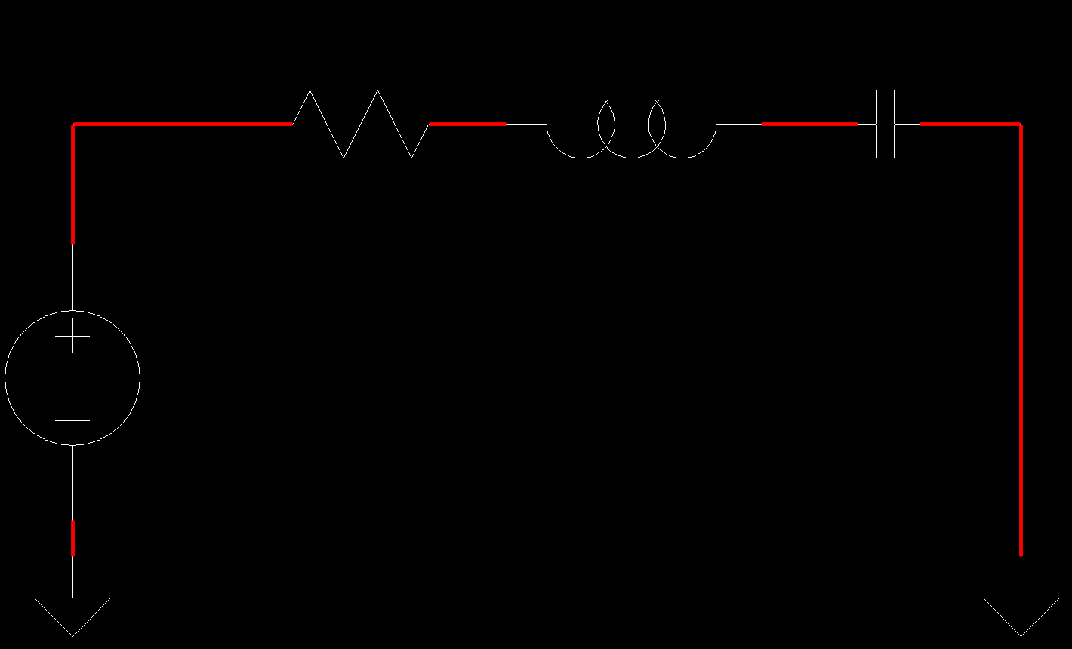
Wire detection

Slide 29
Output generation
Objects in the SIMSCAPE electrical component library have:
Coordinates
Size
Orientation
Ports
Element specific electrical parameters

Slide 30
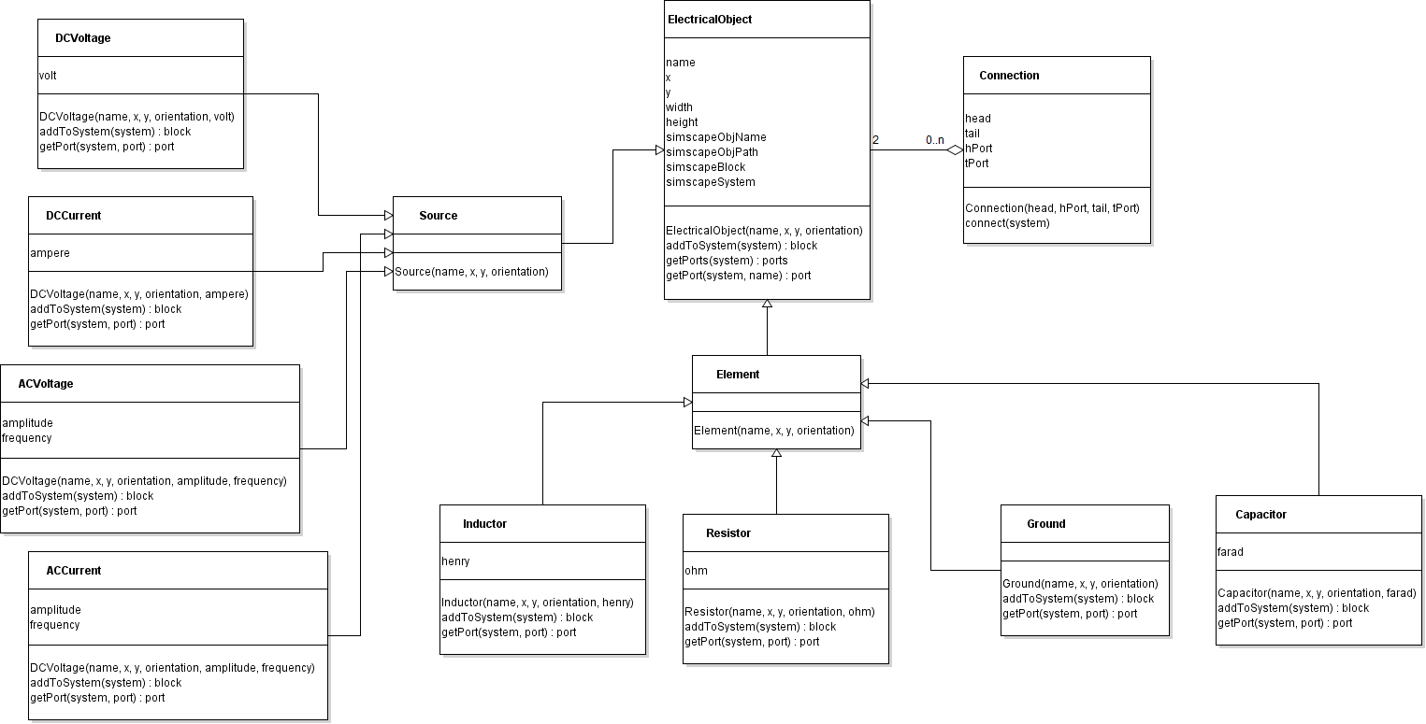
Output generation

Slide 31
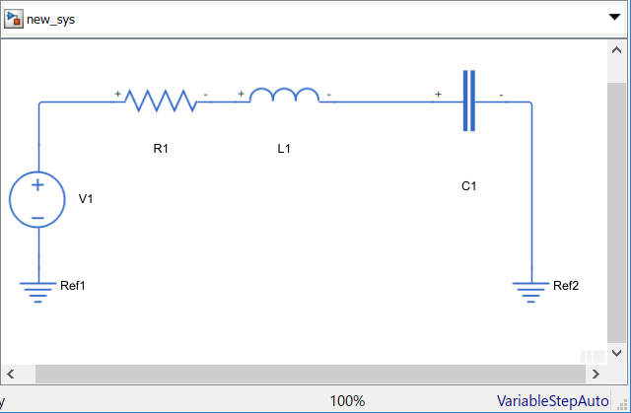
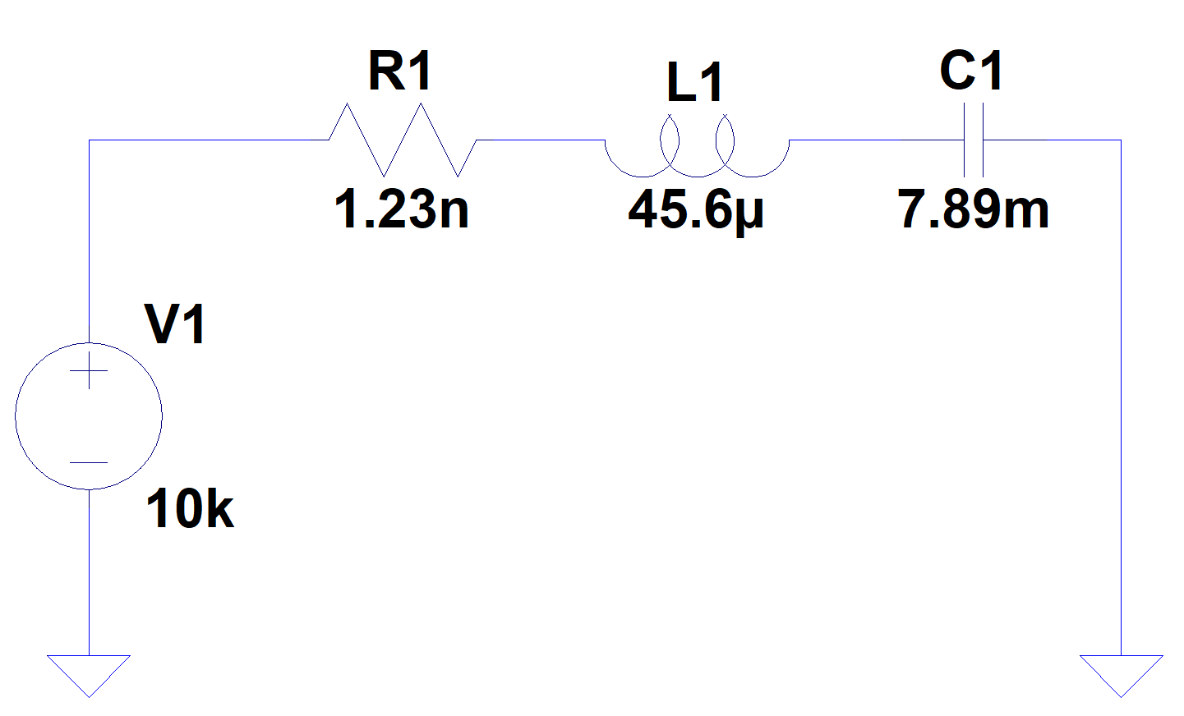
Simscape model

Slide 32
Computer vision Concepts
Preprocessing
Rectifying
Binarization with thresholding
Morphological operations
Object detection
Sliding window algorithm
Hough transform

Slide 33
Thank you for your attention

